Slide 1
NUBTk HUB
Connect-Collaborate-Succeed
Student collaboration platform and Academic Management

Slide 2
Table of contents
1.
Project overview
4.
Output
2.
Project Road Map
3.
Implementation
1.1 Project objective
4.1 Output
4.2 User manual
2.1 Project features
2.2 Project flowchart
3.1 Project code
3.2 User Interface

Slide 3

Project Objective
SCAMP aims to address these challenges and provide a seamless solution for students by:
Enhancing collaboration: Provide a centralized platform for students to connect, share ideas, and work on projects together.
Streamlining academic management: Automate routine tasks, provide real-time updates on course progress, and facilitate communication with instructors.
Improving user experience: Create an intuitive and user-friendly interface that is accessible to all students.

Slide 4
Our key Features
2.1
Authorization and authentication:
LogIn/Create account/Reset Password

Slide 5
Student Profile Management
Share Ideas
Customizable
visability
Comprehensive profile
Personal Information storage

Slide 6
Course Management
1.
Enrolement
Show the list of course enrolled for current semester
2.
Drop course
Show option to drop course
Working Principles
3.
Enroll Course
Show option to add courses
4.
Current Enrollment
Show result after drop or add courses

Slide 7
Academic Management Tools
Attendance management
Academic Calendar
Grade Tracking

Slide 8
Tuition fees
PAYMENT GATEWAY
Bank
Bkash
If Payment Failed
Payment Success
Payment Success payment Failed
Try Again
Current Due
Try Again
Current Due

Slide 9
Collaboration Tools
Real time chat
File sharing
Making schedule with teacher
Security
S
W
O
T

Slide 10
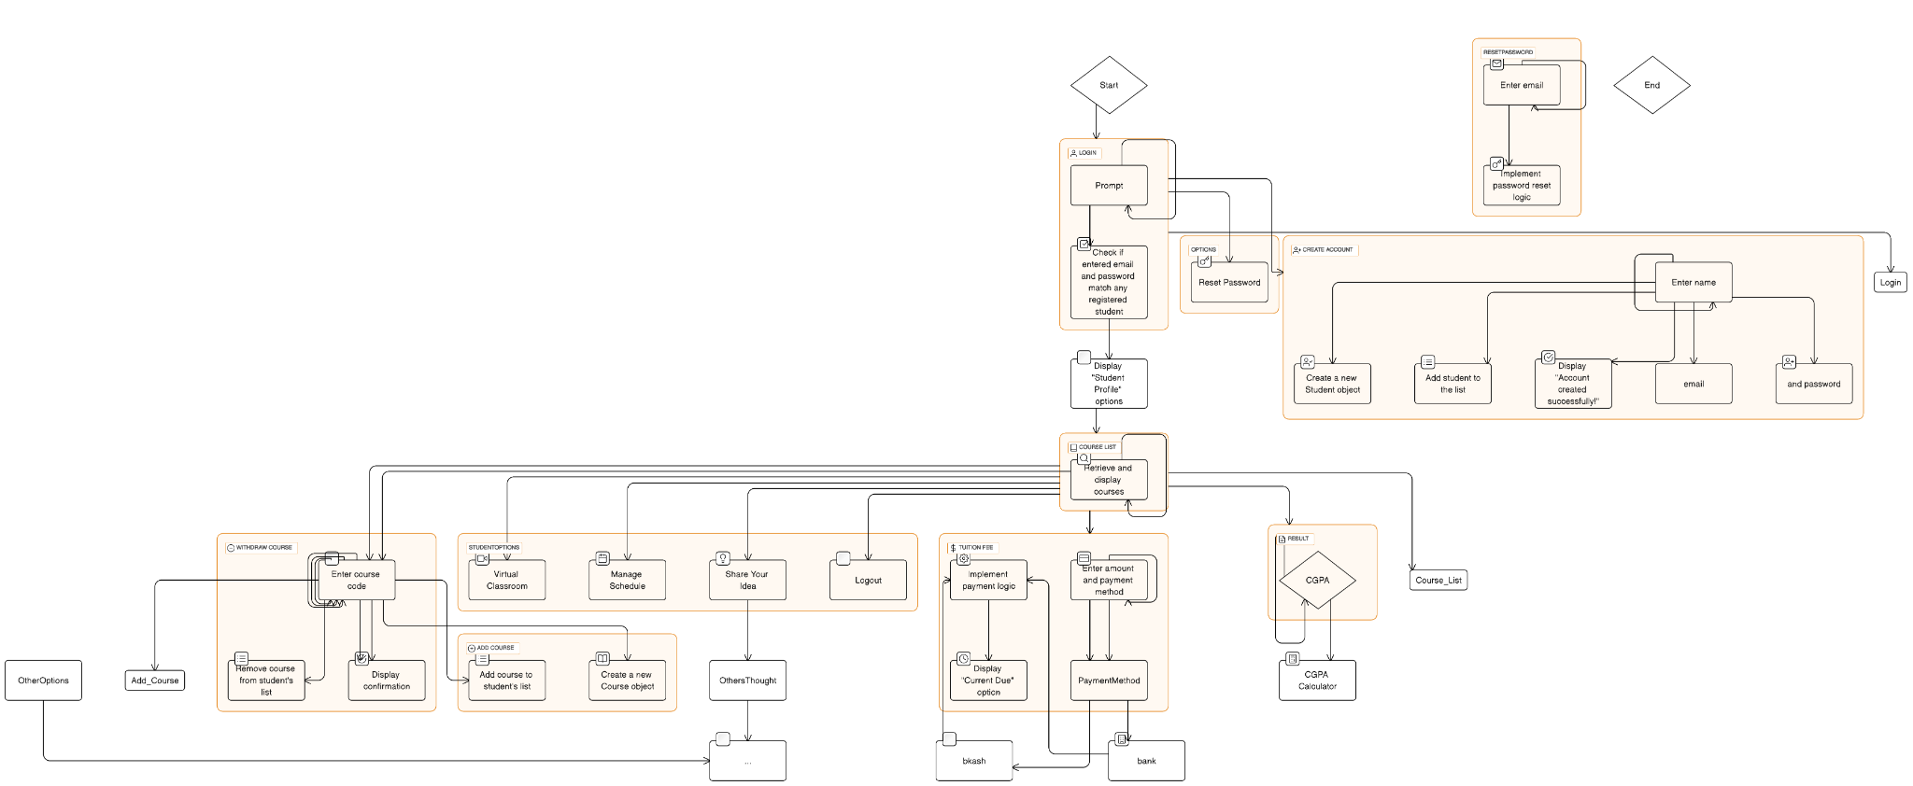
FLOW CHART DIAGRAM

Slide 11


Slide 12


